Slide 1
ROAD ACCIDENTS IN INDIA
Feel the curves but don't hug them.
Presented By : Instructor : Dr. Dootika Vats
Anupam Anand
Kanchan Maan
Rohit Jangid
Snigdha Taneja

Slide 2
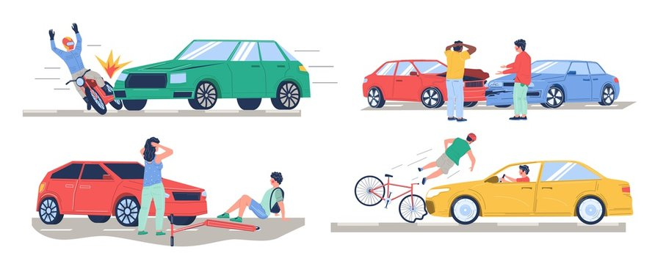
Why Road Accidents?
Possible reasons
Human error
Weather conditions
Alcohol consumption
Occurrence of time

Slide 3
Data Collection :-
PDF to CSV
Publications titled “Road Accidents in India <year>
( 2008 - 2018)” from morth.nic.in were obtained in pdf format and converted to CSV files using online resources. And then loaded in R.
Web Scraping
Data was scraped in the form of tables from the web in R using the library rvest.
02
MS Excel CSV file
Majority of the data was collected in csv format from the data.gov.in
01
03

Slide 4
Sources of Data :-
morth.nic.in
Yearly publications from Ministry of Road Transportation and Highways
data.gov.in
Open Government Data Portal designed, developed and hosted by the National Informatics Centre (NIC)
cot.gujarat.gov.in
cot.gujarat.gov.in/road-accidents.htm the data was scraped from a Gujrat government website.
statisticstimes.com
Expected population of the year 2019 was extracted for the analysis.
en.wikipedia.org
https://en.wikipedia.org/wiki/List_of_cities_in_India_by_populution
List of major cities in India by population was scraped from the above link
classmate4u.com
Latitude coordinates of States from
https://www.classmate4u.com/latitude-and-longitude-of-india/

Slide 5
Key Questions Of Interest
01
Was there a significant decline in the number of road accidents after alcohol was banned in Gujarat in the year 2009?
Drunk Driving
02
Is there any relationship between the number of registered vehicles in a city with the total number of accidents in the city with respect to the population of the city?
Vehicles Count
03
What hours of the day can be considered to be the peak hours of the occurrence of road accidents in India?
Time of Occurrence
Out of all the available causes of road accidents in India which of them is the principal cause for the occurrence of road accidents in each state?
04
Contributing Factors
05
How are the road accidents in states of India affected by the weather conditions ?
Weather

Slide 6
CONSTRAINTS
Vehicle Count
Time of Occurrence
As the sources of all the three present variables , was different, therefore, a few cities were dropped from the final data frame because they were not common in all three data set.
A categorical column namely “TYPE” was added in the data set to categorize the hours into day and night
Factors Affecting
Population
From the year 2020 , Jammu and Kashmir is considered as a state instead of a UT for the sake of analysis and comparison with previous year data.
The expected population of 2019 was used in the state-wise analysis of factors affecting the road accidents.

Slide 7
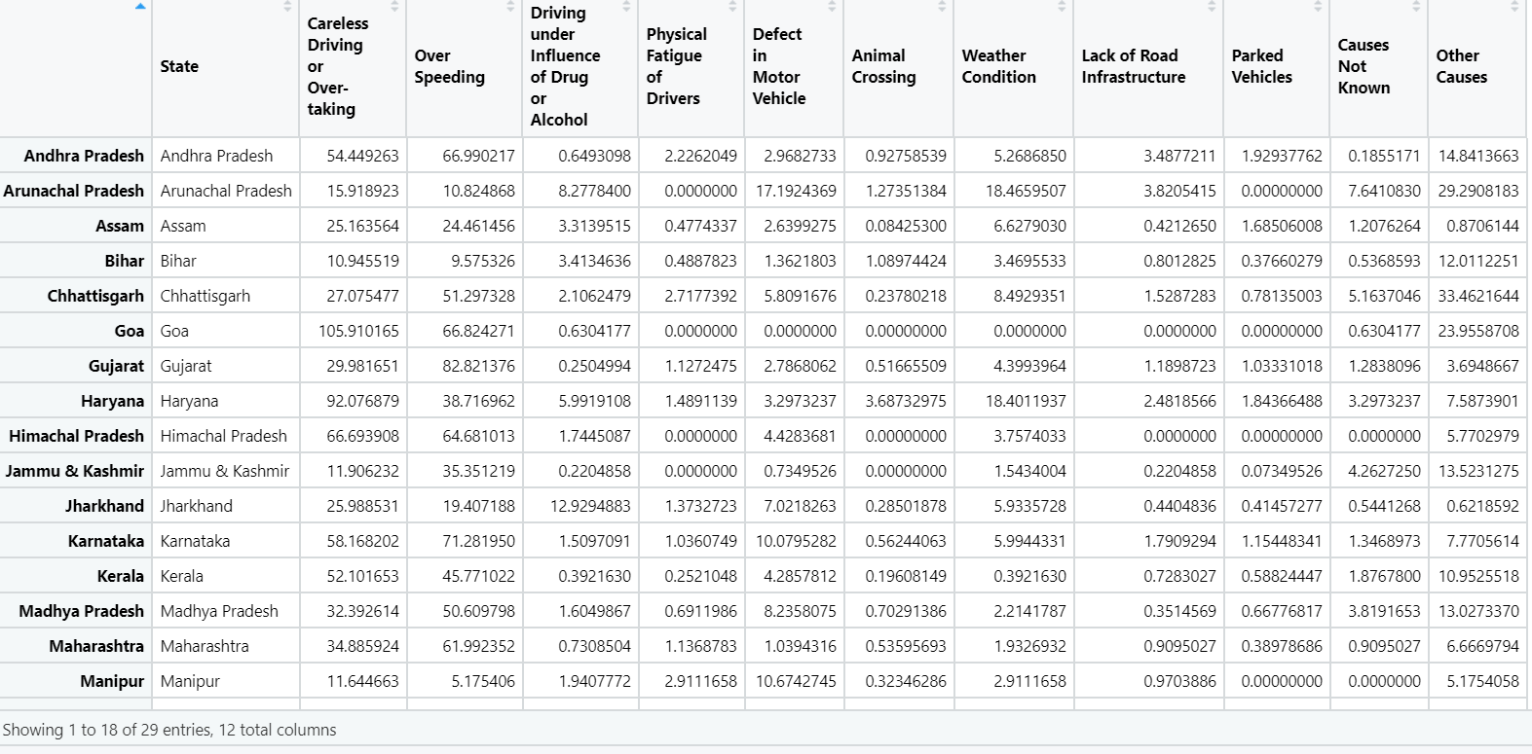
Dataset of states to analyze the number of road accidents due to different causes.

Slide 8
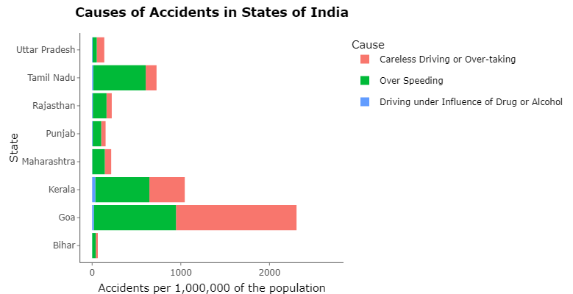
Observations
Clearly, overspeeding and careless driving contributes majorly in all states of INDIA

Slide 9
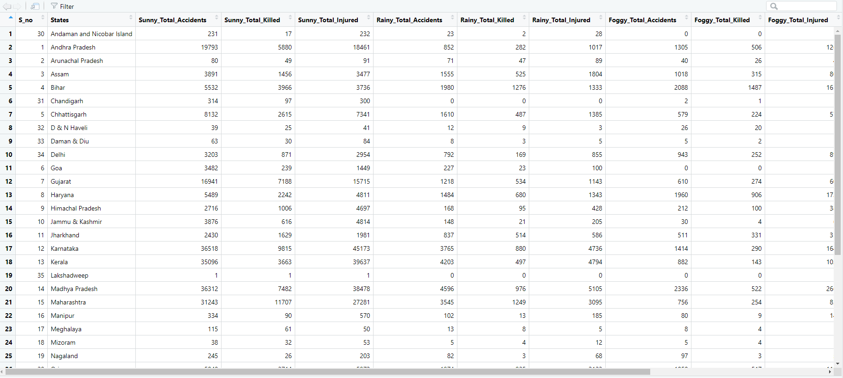
Dataset for State and UT wise analysis of road accidents

Slide 10
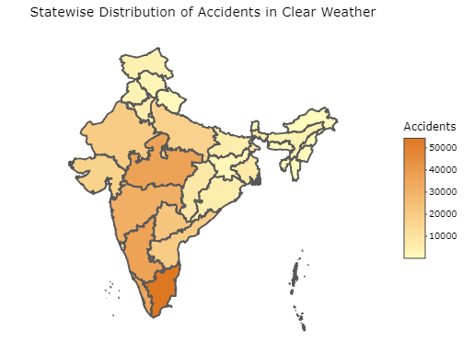
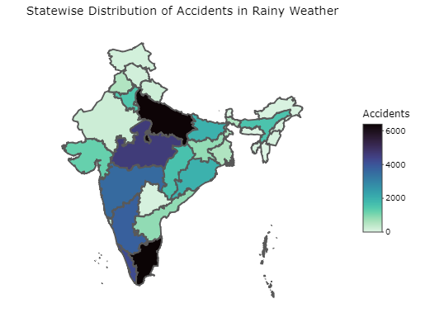
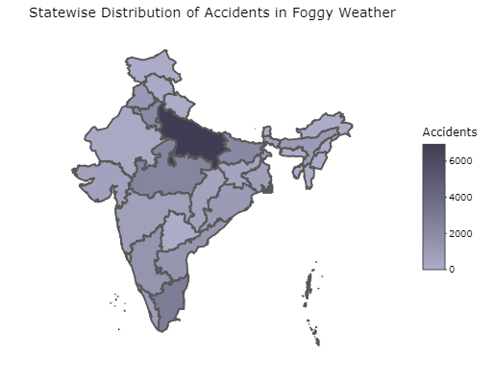
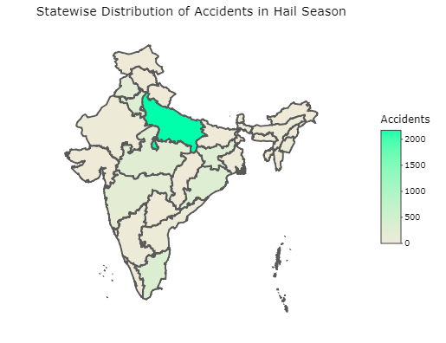
OBSERVATIONS
Uttar Pradesh and Tamil Nadu record the maximum number of road accidents be it any type of weather.
It can be observed that Assam has reported more cases in Rainy Season than in any other weather condition.
The Foggy and Hail Season witnesses a comparatively low road accident all over India, specifically in the coastal regions.

Slide 11
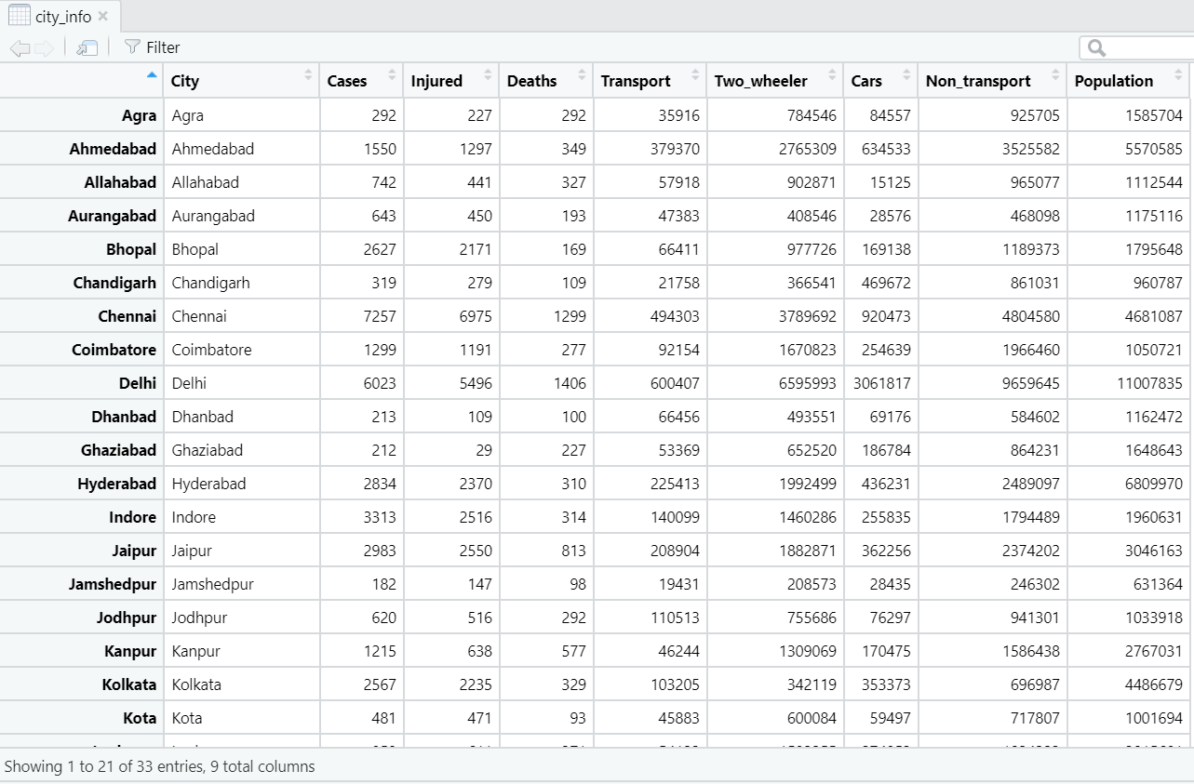
Data used to analyze road accidents in different cities with respect to the number of registered vehicles and population

Slide 12
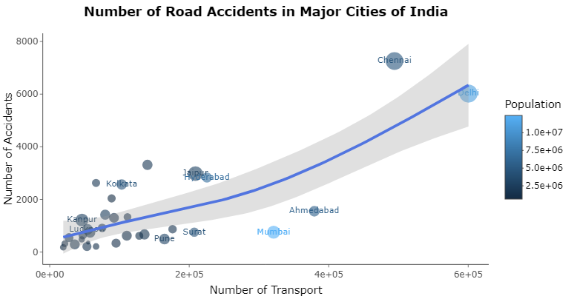
OBSERVATIONS
Chennai and Mumbai are outliers in the sense that they deviate from the average trend.
Mumbai has less number of accidents and fewer registered vehicles despite having a large population.
Chennai has more registered vehicles and a large number of road accidents.

Slide 13
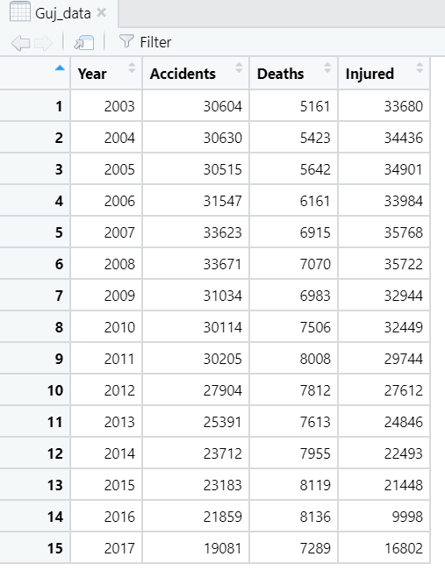
Data used to analyze the road accidents in Gujarat after ban on alcohol

Slide 14
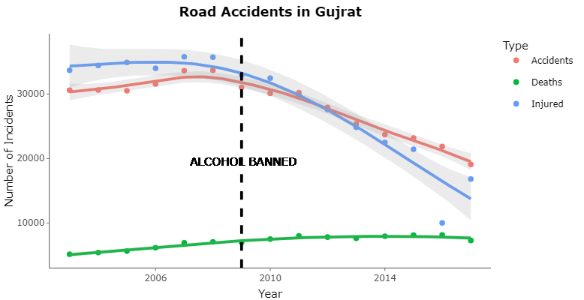
It can be observed that there is a major decline in the number of road accidents in Gujarat after the ban on alcohol in the year 2009.

Slide 15
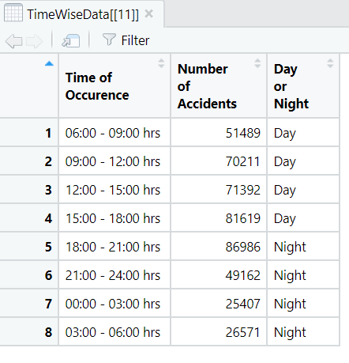
Data used to analyze road accidents in India according to the Time of Occurrence
Year : 2018

Slide 16
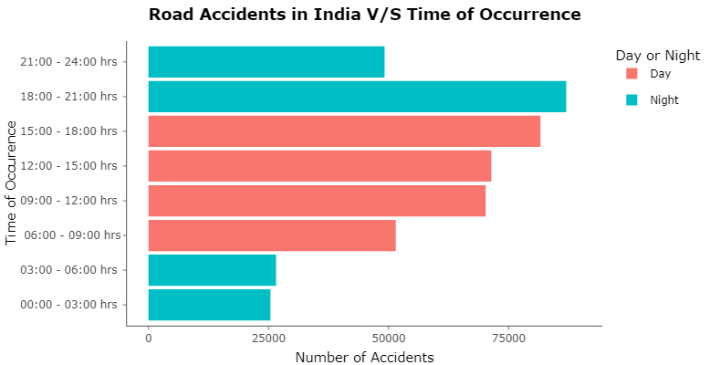
The hours from 3:00 p.m. to 9:00 p.m. observe a maximum number of road accidents in a day.

Slide 17
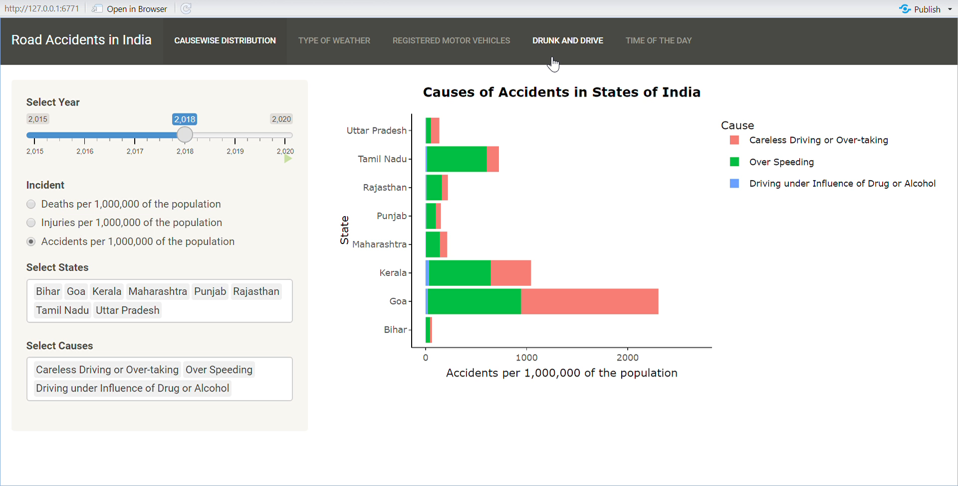
SHINY APP

Slide 18
SOME FINDINGS :
1. Over-speeding and careless driving are two major factors contributing in the road accidents in all the states. 2. In rainy season, the neighboring states of Maharashtra, Karnataka, and Tamil Nadu witness high road accidents in the coastal areas. 3. It is not necessary that high cases in the states presented have a high number of road accidents because it can also mean that the cases occurring are also being reported proportionally in these states might not be the case in other states 4. In Mumbai the people prefer to travel using local transport. Moreover Maharashtra has invested on more infrastructure and surveillance as well as high fines to curb road accidents. Chennai has almost everything that can result in severe road accidents. From dysfunctional traffic signals to non operational street lights, inadequate policing (not so efficient traffic police) and low fines on violation of traffic rules. 5. Ban on alcohol has helped Gujarat curb road accidents to a major extent. 6. The time from 9:00 a.m. to 6:00 pm. in the day witnesses a maximum number of road accidents and 6:00p.m. to 9:00p.m. is the time in the night

Slide 19
REFERENCES
https://timesofindia.indiatimes.com/city/mumbai/mumbai-5th-among-cities-to-curb-road-accidents-in-a-year/articleshow/78801577.cms
https://en.wikipedia.org/wiki/Road_accidents_in_Tamil_Nadu
https://www.dailypioneer.com/2013/page1/states-asked-to-emulate-guj-in-good-spirit.html

Slide 20
THANK YOU

